Slide 1

Roof Truss design in Solidworks and use in second life
agbell

Slide 2
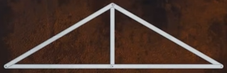
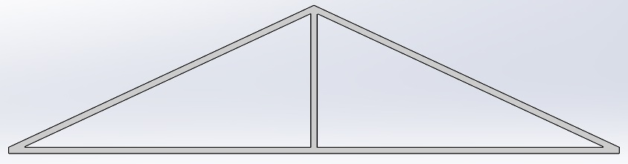
To better visualize roof truss design student in the METC 111 class were assigned a task to design and build in Solidworks a 28 foot roof truss with a 25 degree pitch. There roof truss design would then be imported into Second Life and placed on a 28 foot by 28 foot square garage. Each student would be assigned a garage an would add their roof truss to the top of the garage.
The model (sldprt) is created in Solidworks Smart Dimensions and Extrude Boss/Base commands based on the 28 foot width and 25 degree pitch.
The model is exported as a stl file.
King post roof truss
King post roof truss - Solidworks

Slide 3
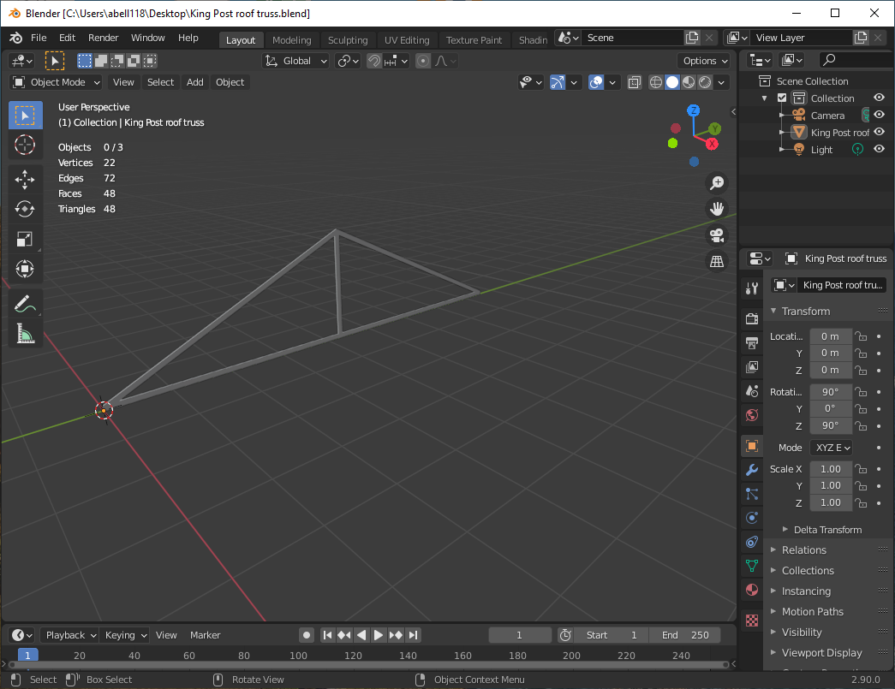
The stl file is imported into Blender and exported as a dae file for Second Life. The Vertices, Edges, Faces and Triangles are pretty small so this will be a good and inexpensive model in Second Life.
Also need to create the physics model with is just the outline of the truss which should be the same for all roof truss with a width of 28 ft and pitch of 25 degrees.

Slide 4
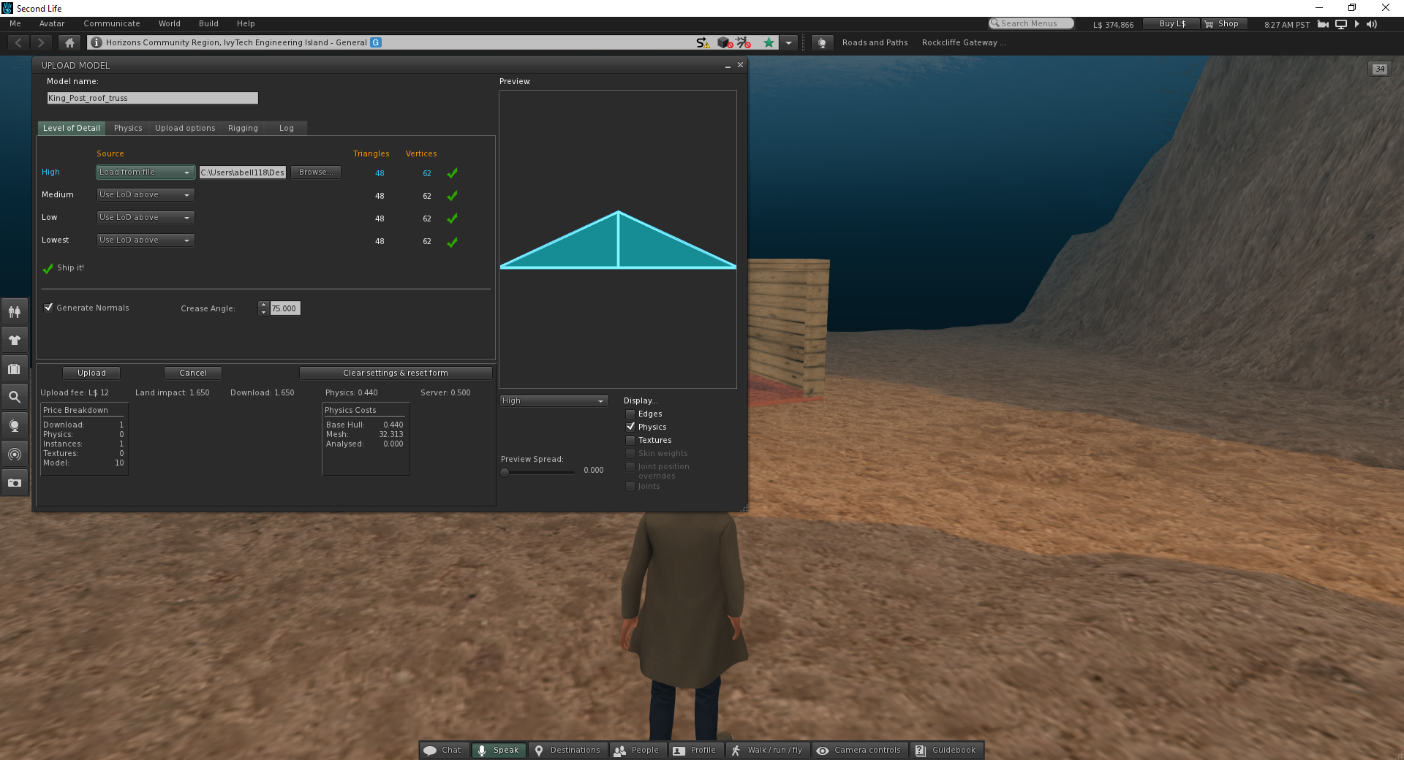
Upload both the model and physics file. L$ 12 is pretty good cost.
This object (model) will then go in your inventory

Slide 5
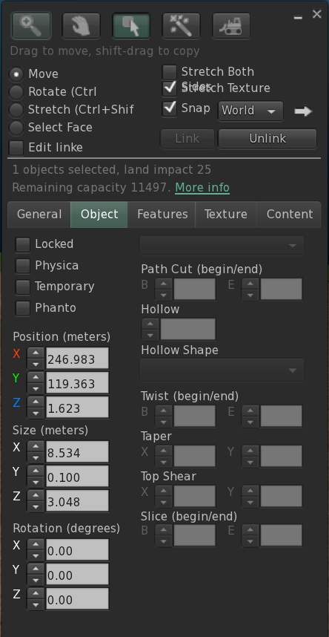
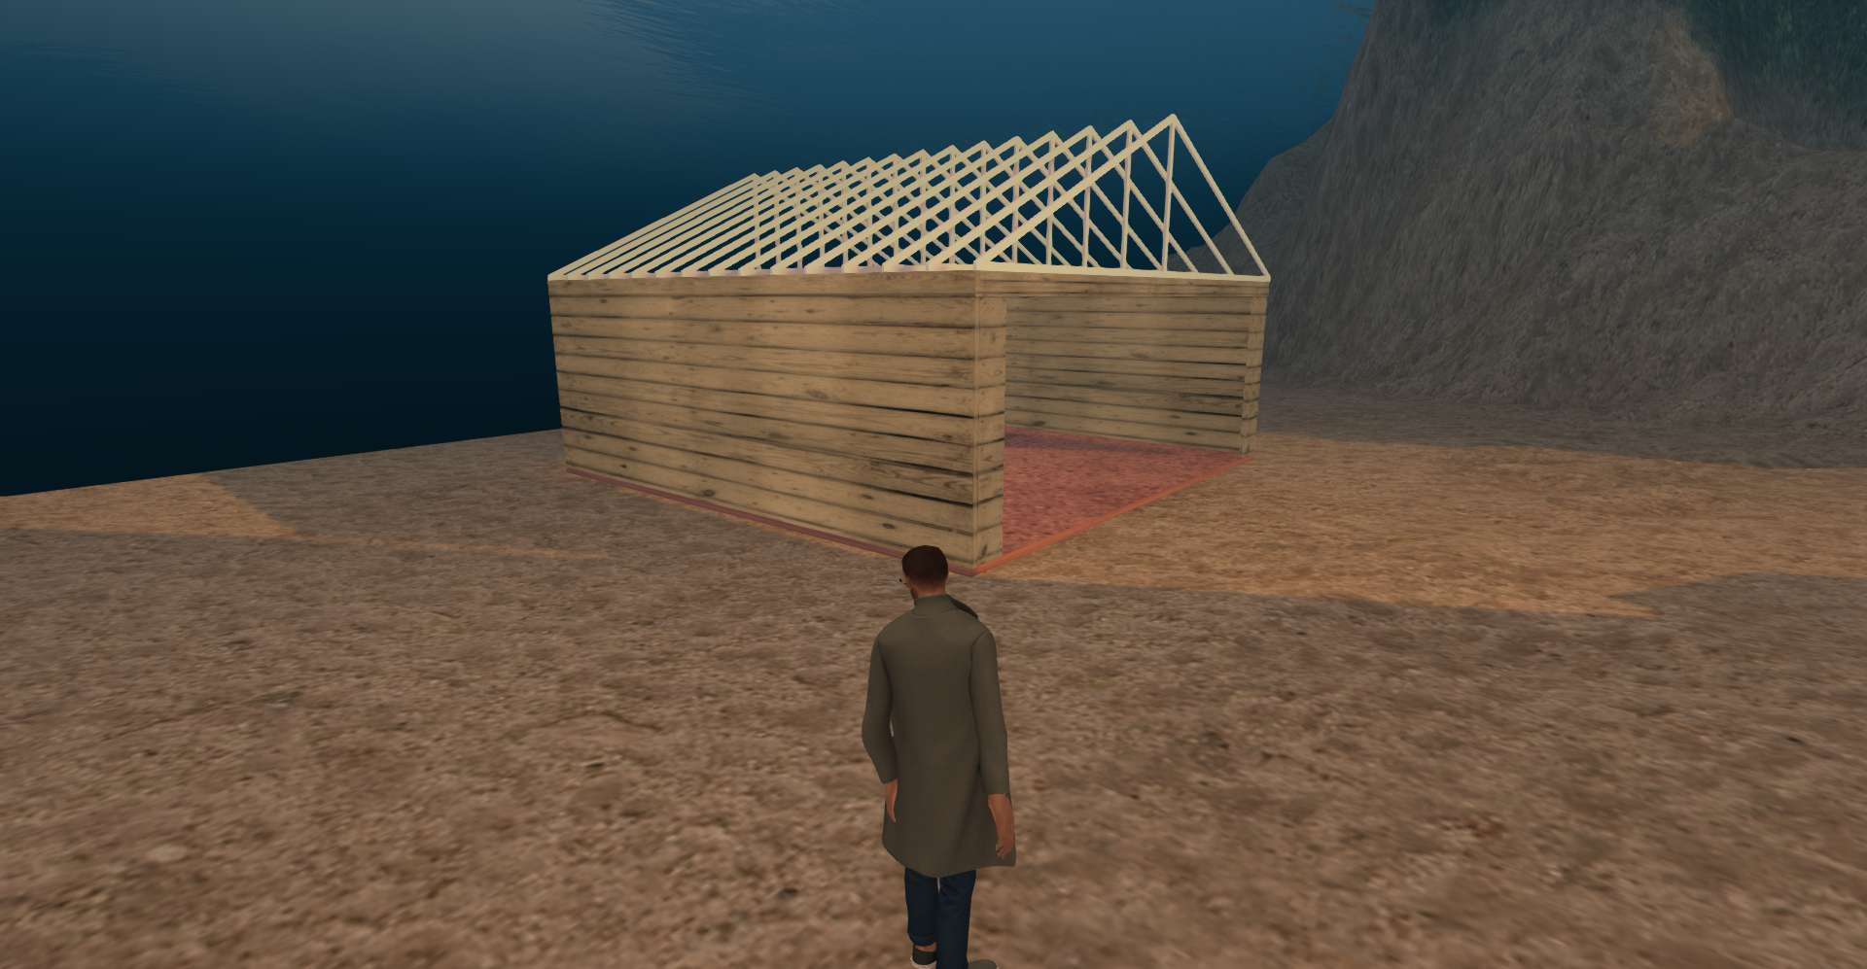
Your instructor will upload your roof truss and place it in the build area for you to use. You will need to copy and move the truss to the top of your garage. Your truss should be 28 ft wide and you should place trusses on the top of the walls. The when all the trusses are place (24 inch on center), you can link everything together and save your garage as a full assembly.
You may need to experiment with linking to insure that the garage’s x, y and z “origin” is at a common reference point inworld. Typically, the last item linked sets the reference location and in this case for each garage it would be the left wall.

