Slide 1
Making a Mountain using Second Life from Terrain.Raw file
AGBell
4/23/2022

Slide 2
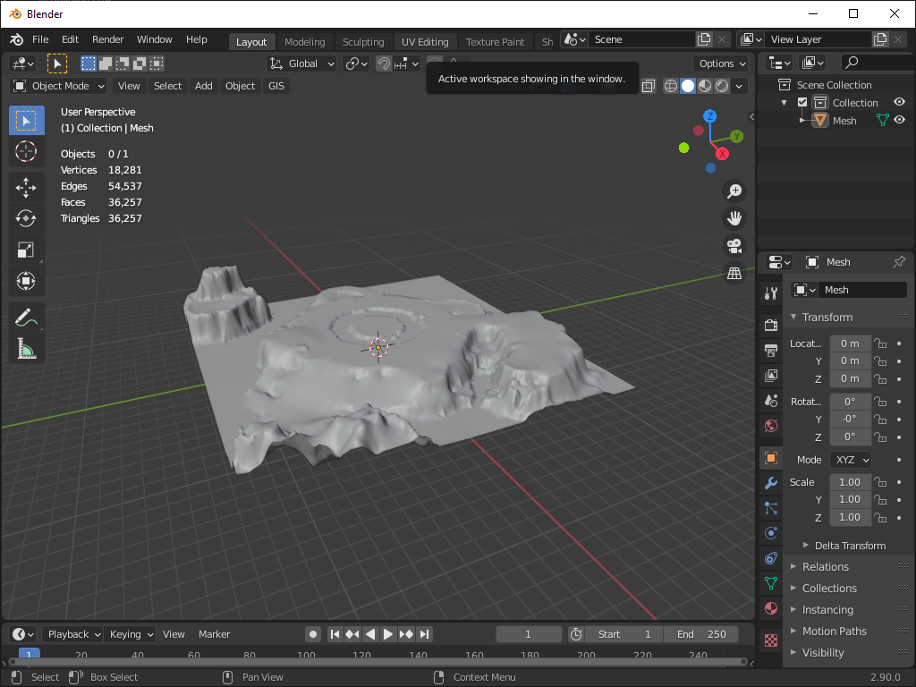
Step 1- after you have converted you terrain.raw into a mesh (dae) you can start the long process of editing the mesh to reduce it’s poly count (vertices, edges, tris and quads). The major objective is to reduce the geometry so we upload the model into Second Life.
This model has way to much geometry and should probably
Be simplified to only focus on the mountain in the corner of the terrain. Everything else can be deleted.

Slide 3
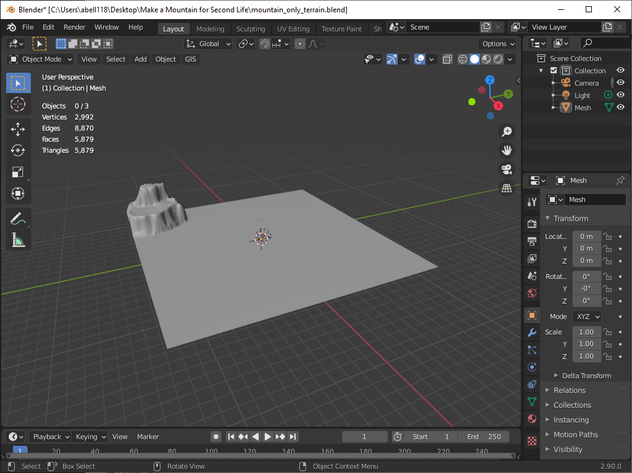
Step 2- reduce mesh to only the mountain. In my initial attempt I request a empty region from Linden Labs and then attempted to import and simplify my terrain. This was a good approach but some recommended using OpenSim to do this job but it
took time to get OpenSim and the version of Firestorm installed on my school computer. If you do not have admin right some of this work will be difficult to do until you get all the software you need installed.
The truth is I didn’t really need to simplify the mesh since I only wanted the mountain mesh model. This can be extracted directly by editing the original terrain.blend file.

Slide 4
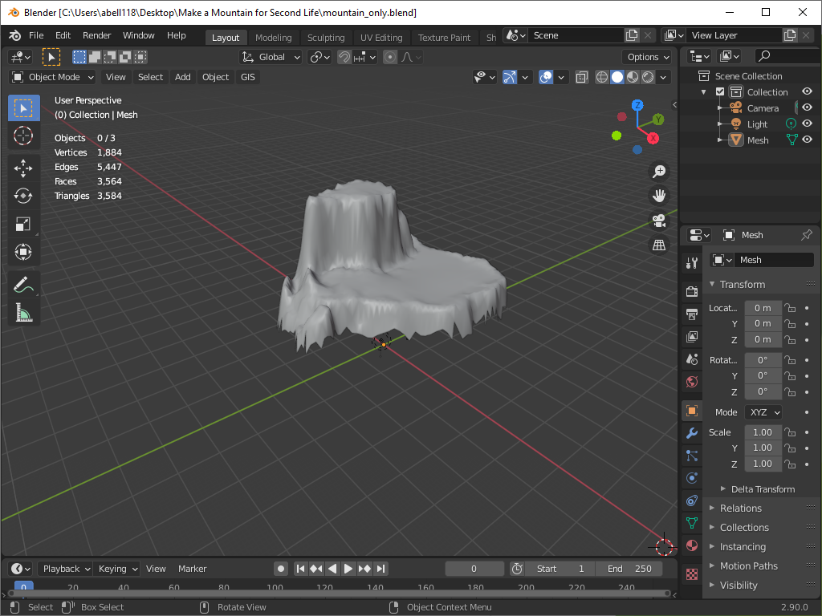
Step 3 – we still need to reduce the mesh. This can be done in edit mode by deleting faces. This seems like a good start but I don’t like the jagged edge along the bottom of the mountain. Maybe try again and just delete the faces on the bottom of the mesh that you do not want.

Slide 5
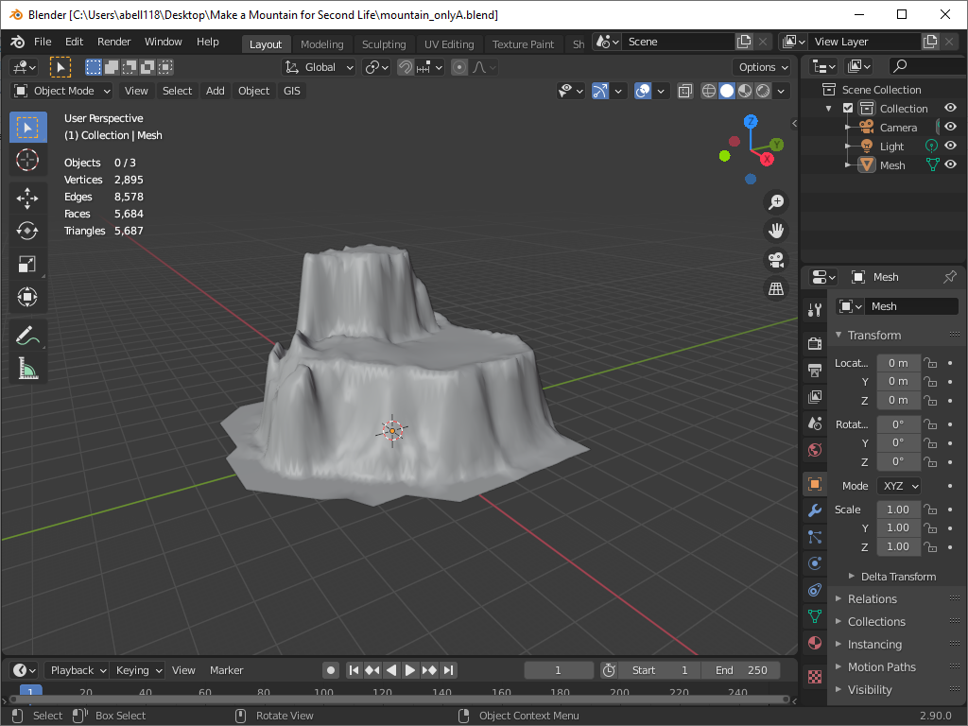
Step 4- In edit mode, delete all the faces on the bottom of the mesh that you do not want. This doesn’t seem to reduce the mesh very much because these faces are big and few. We also want to cut the slice the bottom of the mesh up 20 meters from the
floor because this island mountain will be floated above the based of the ocean floor. This was one of the major reasons why we wanted to translate the terrain into a mesh, so we could have access to the build area under the mountain.

Slide 6
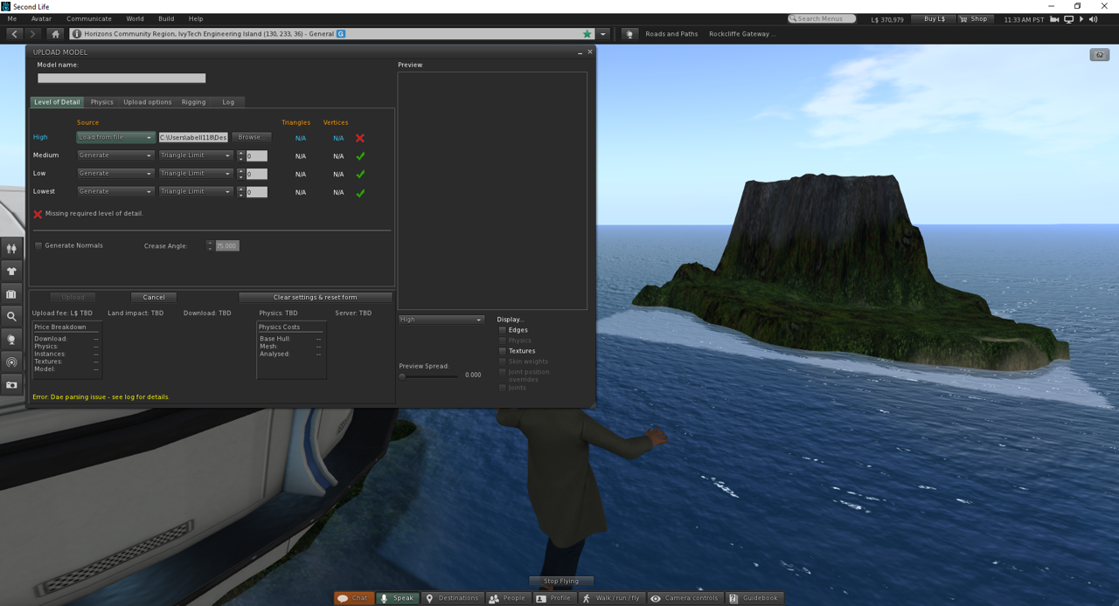
Step 4 (continue) - I did attempt to just upload this model and got an error “DAE parsing issue” I asked people in the Forum 9 March 2022 - Another riddle - I was able to create several dae models using two different terrain files. One with the original terrain and the other one with a terrain that only had the mountain island in it. Both could be uploaded to SL with any issue. Then I tried to reduce the mesh to only the mountain island and tried to upload it. I did not do anything but delete or dissolve vertices, lines or faces and when I export as a DAE and try to upload I get this error.
The response I got back was – The reason for the parsing error is because the X Y and Z scale of the object is 1 instead of 1 (plus the X Y and Z rotations should all be at 0° before exporting).
In Object mode select model and open the Apply menu with Ctrl A and choose the All Transforms option.
After Apply scale and rotation you will need to Flip the face normals. In Edit mode and all of model selected Alt + N > Flip.

Slide 7
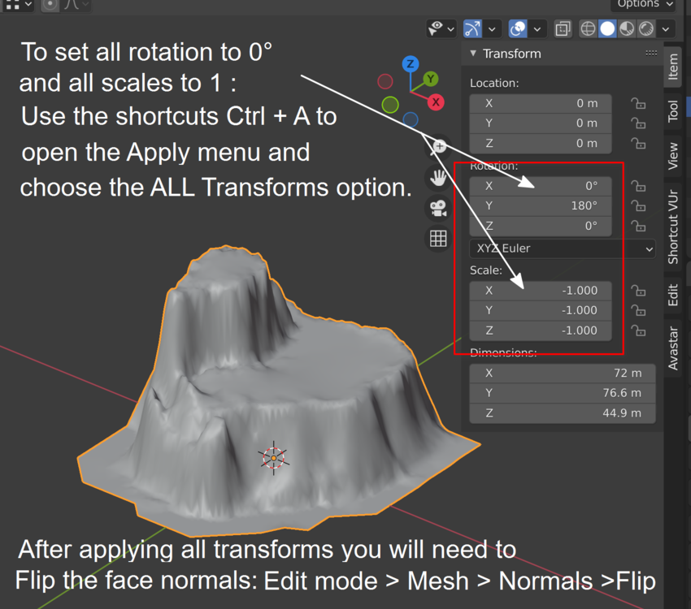
Step 4 (continue) – The fix is easy to do but yet another example of the complexities in developing a model for Second Life outside of Second Life.

Slide 8
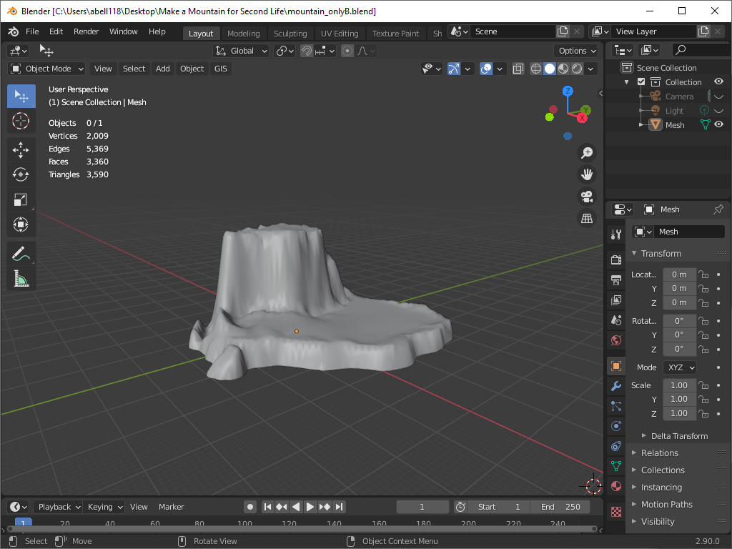
Step 5- Cut the bottom off the base of the mountain. This is really the mesh model we need to start with. So far so good but it has taken some time to get here. The model looks great but will it upload to Second Life. To evaluate let’s try to upload to Second Life.

Slide 9
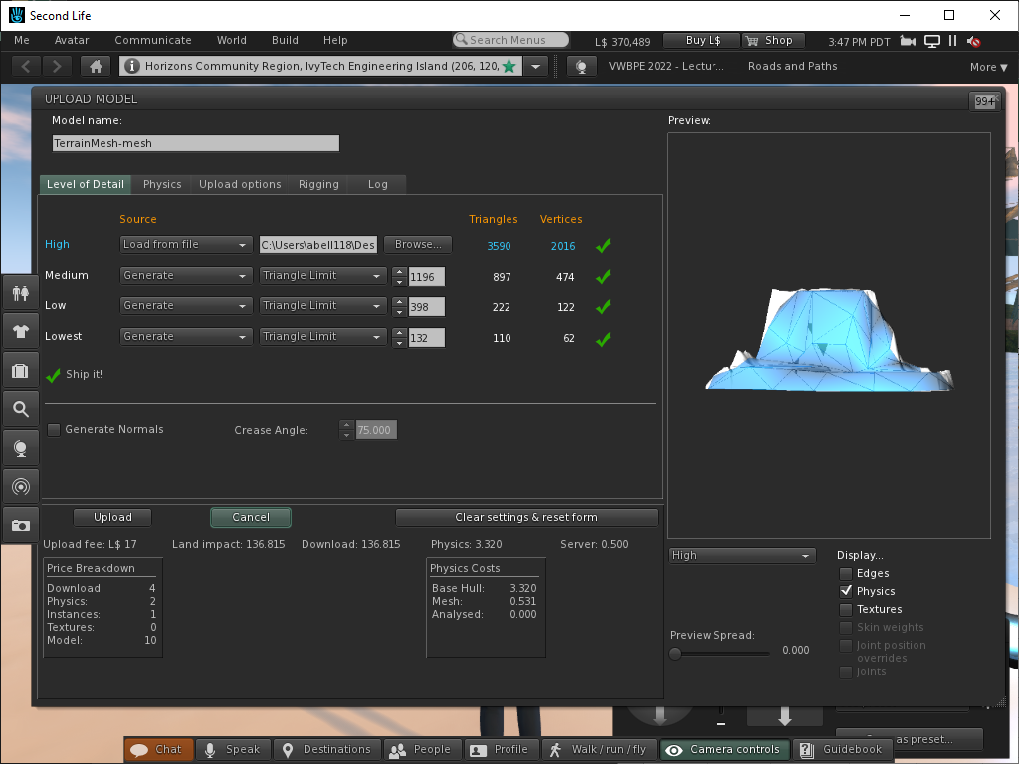
Step 5- The model will upload but the physics looks bad and the Land Impact higher than I have seen for other models in the Second Life Marketplace. The model needs to be simplified so the Land Impact is more like ~ 20.

Slide 10
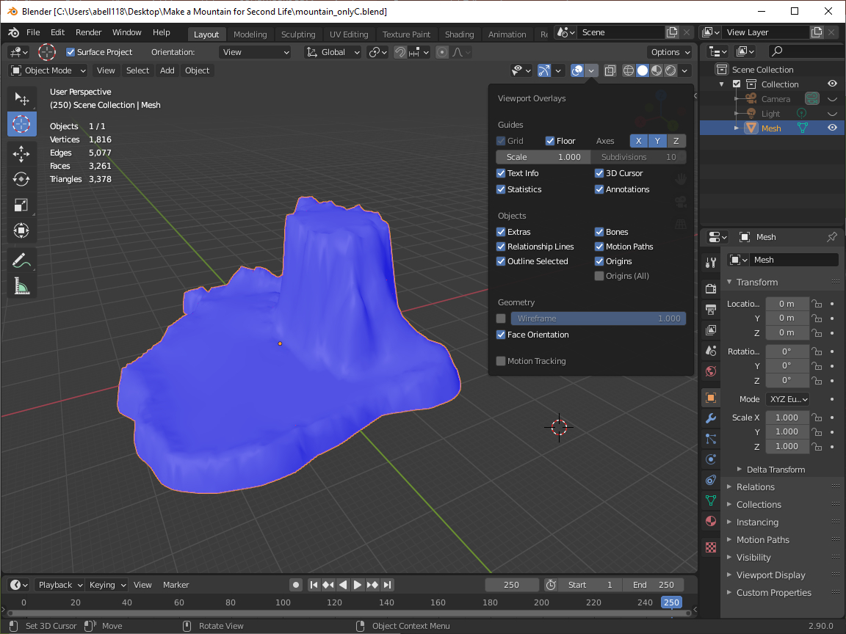
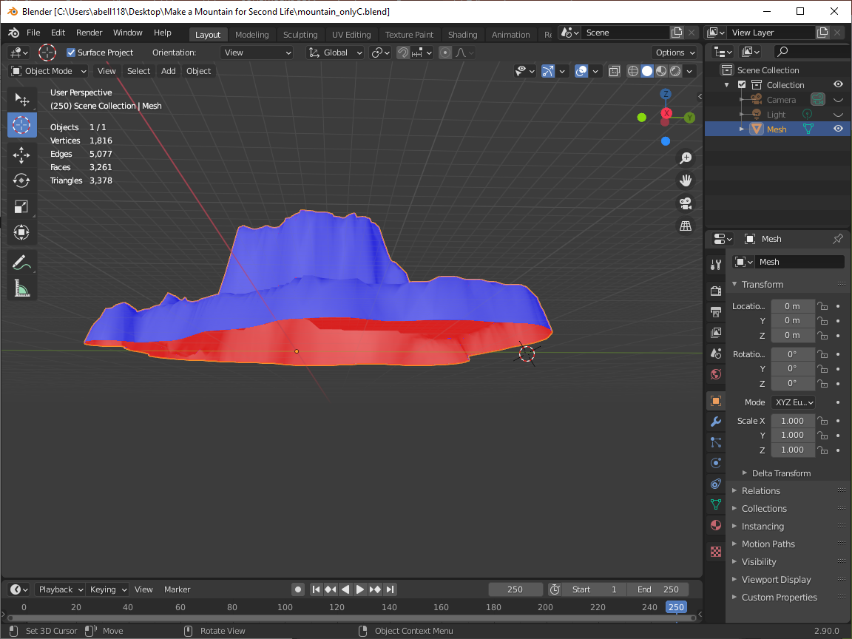
Step 6 – This picture shows that the normal have been properly flipped however I want the bottom of the mesh filled. I saved this version of the model and moved onto the next step which is to fill the based of the model.

Slide 11
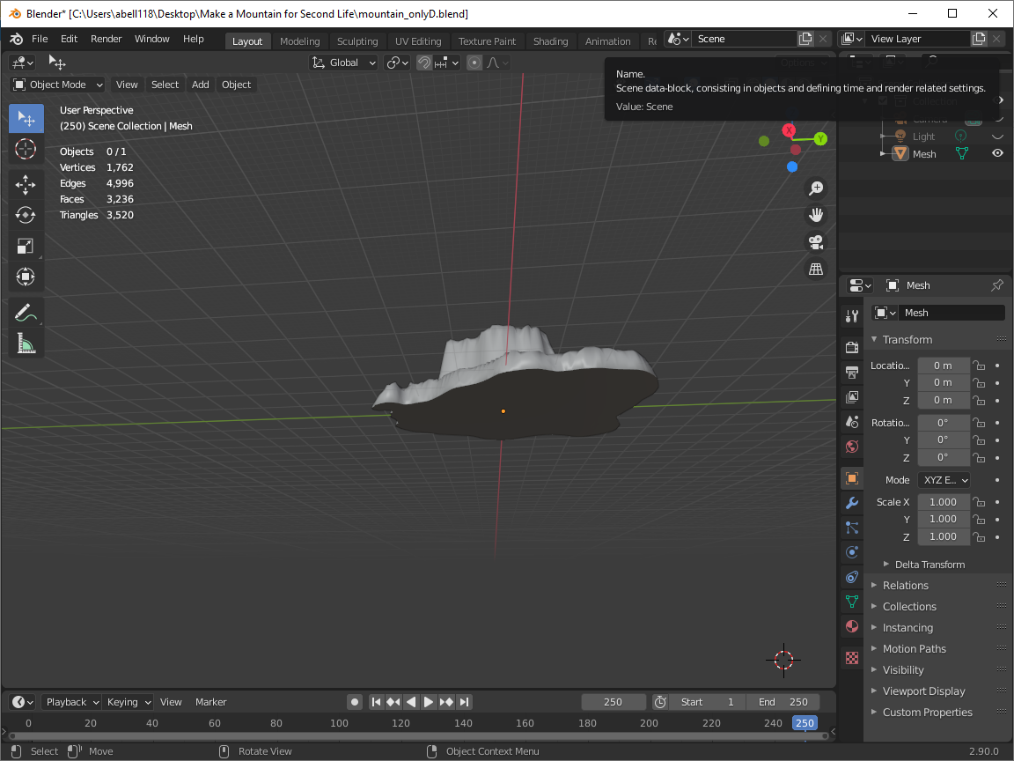
Step 7 – Filling the base of the model was far more challenging than it should have been. Along the way I found many extra vertices and edges that were in odd places that needed to be deleted. Just filling the base of the model took forever.
The basic techniques is to select vertices in Edit mode and hit the “f” key to fill the bottom of the model. You will need to do this around the entire bottom and “dissolve or delete” any unwanted edges. Sometimes you can be in an Orthographic view like Front or Right and do a select a number of vertices at the same time. Then you can with the Shift key depressed rotate the part and select more vertices. Then hit the “f” key but if you select a vertices that is not wanted you will need to redo it.

Slide 12
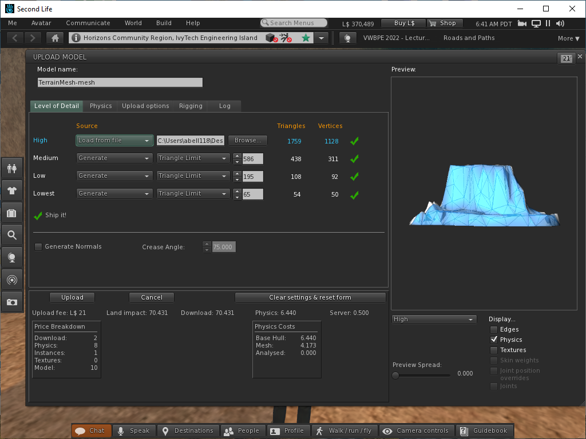
Step 8 – At this point I thought I was pretty much done but I wanted to simplify the mesh a little more using a Decimation modifier. In the Forum I wrote 16 March 2022 - I am curious about the texture. How could I make a mesh model look better? OBTW, this
is the decimated island and drawn island
Decimate Drawn in Planar=0.5 Blender Vertices = 882 515 Edges = 2555 984 Faces = 1675 449 Triangles = 1759 934
Still need to work on the physics
models... But I was able to increase they physics model to the Medium LOD.

Slide 13
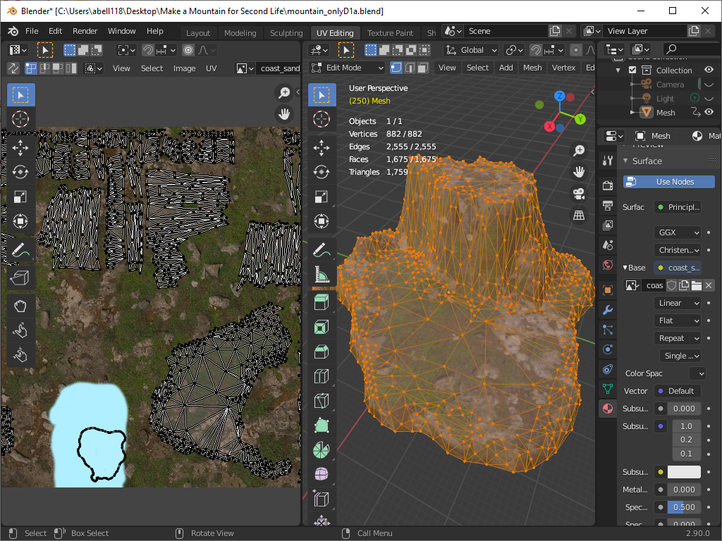
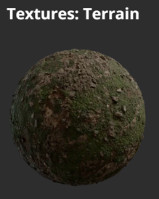
Step 9 – The model can be textured now or additional mesh reduction can be performed manually. Mesh reduction is needed to reduce the Land Impact will adding texture will make the model look more realistic. The model can be unwrapped and a
texture can be applied to all the faces.
In this case a texture was downloaded from https://polyhaven.com/textures
The 2K Coast Sand Rocks 02

Slide 14
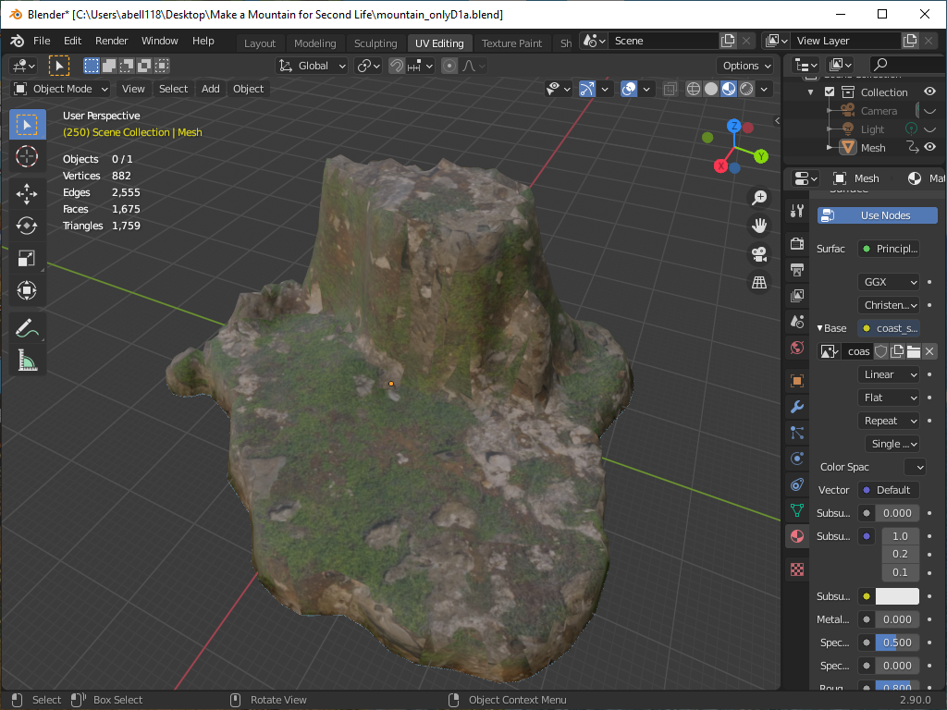
Step 9 (continued) – The model looks good but maybe I should do more work on reducing the mesh. I am also not really happy because the mesh model and original terrain look so much different. I also had the idea that maybe I also wanted to add a
cave to the model. This would not be possible with the original terrain file.

Slide 15
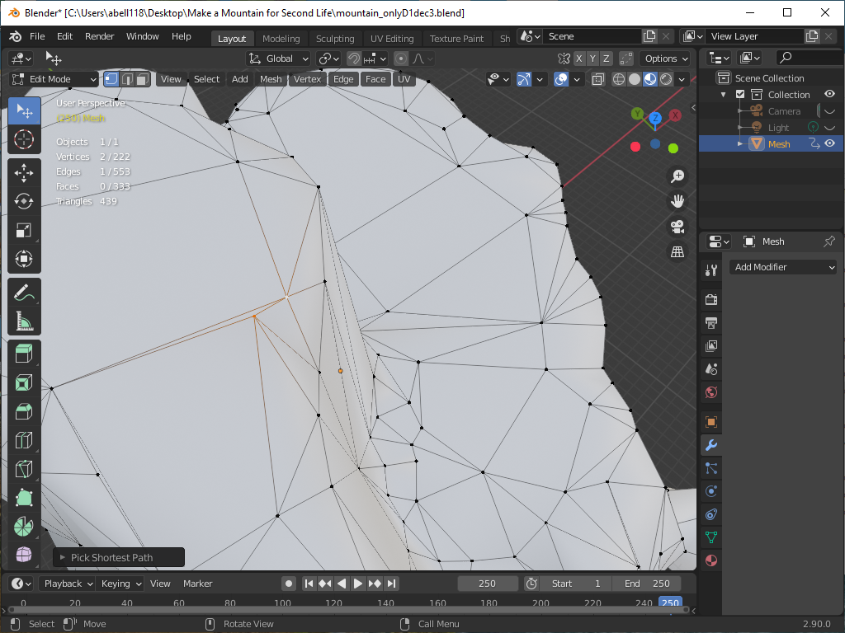

Slide 16
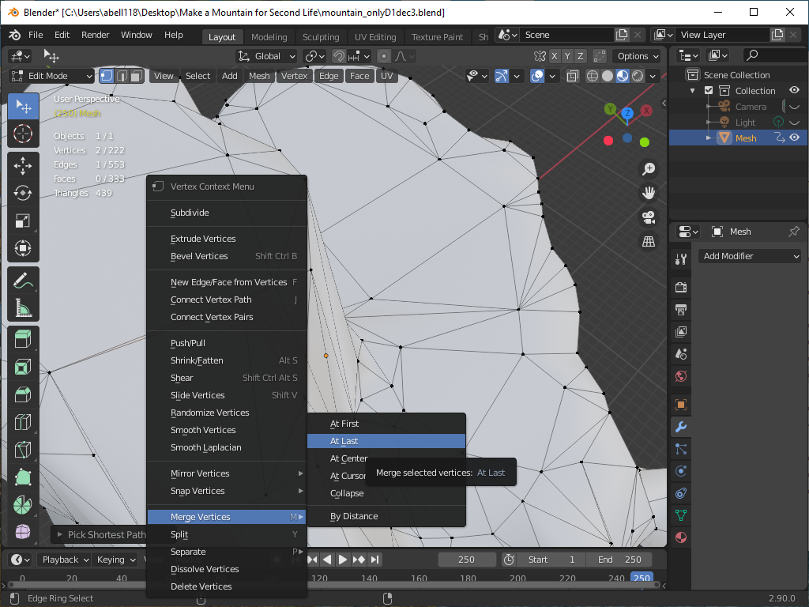

Slide 17
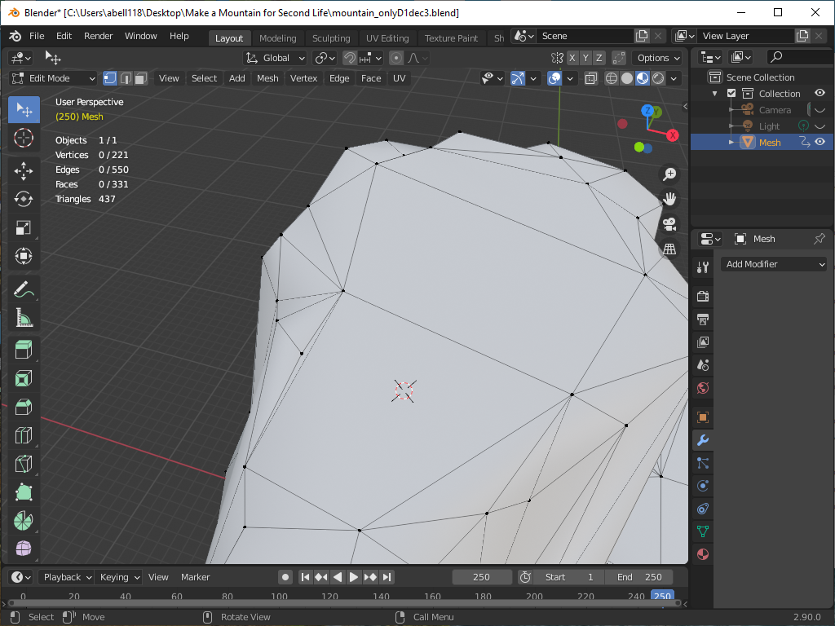

Slide 18
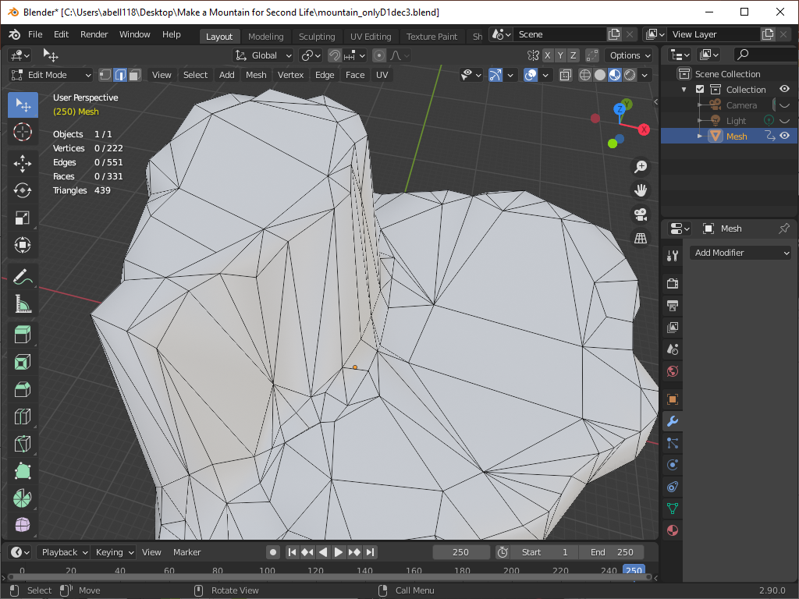

Slide 19
